Slide 1
Setting Up a Development Server
If you wish to develop Internet applications but don’t have your own development server, you will have to upload every modification you make to a server somewhere else on the Web before you can test it.
On a local computer, however, testing can be as easy as saving an update
Another advantage of a development server is that you don’t have to worry about embarrassing errors or security problems while you’re writing and testing

Slide 2
What Is a WAMP, MAMP, or LAMP?
WAMP, MAMP, and LAMP are abbreviations for:
“Windows, Apache, MySQL, and PHP”
“Mac, Apache, MySQL, and PHP”
“Linux, Apache, MySQL, and PHP”
These abbreviations describe a fully functioning setup used for developing dynamic Internet web pages.

Slide 3
What Is a WAMP, MAMP, or LAMP?
WAMPs, MAMPs, and LAMPs come in the form of a package that binds the bundled programs together so that you don’t have to install and set them up separately.
This means you can simply download and install a single program, and follow a few easy prompts, to get your web development server up and running in the quickest time with a minimum hassle.

Slide 4
What Is a WAMP, MAMP, or LAMP?
NOTE:
During installation, several default settings are created for you.
The security configurations of such an installation will not be as tight as on a production web server, because it is optimized for local use.
For these reasons, you should never install such a setup as a production server.
But for developing and testing websites and applications, one of these installations should be entirely sufficient.

Slide 5
Installing XAMPP
Out of the various open source and free options, the best is probably XAMPP.
You can download it at http://apachefriends.org
LINUX NOTE:
Many Linux versions come preinstalled with a web server and MySQL, and the chances are that you may already be all set to go.
To find out, try entering the following into a browser and see whether you get a default document root web page:
http://localhost
If this works, you probably have the Apache server installed and may well have MySQL up and running too

Slide 6
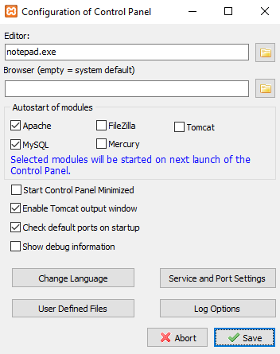
Installing XAMPP
The first thing I recommend you do is click the Config button at the top-right corner

Slide 7
Installing XAMPP
The default ports assigned will normally be port 80 for the Apache web server, 443 for SSL, and 3306 for MySQL.
If you change these values, make sure you insert these changed values in place of any defaults used later on during the course.

Slide 8
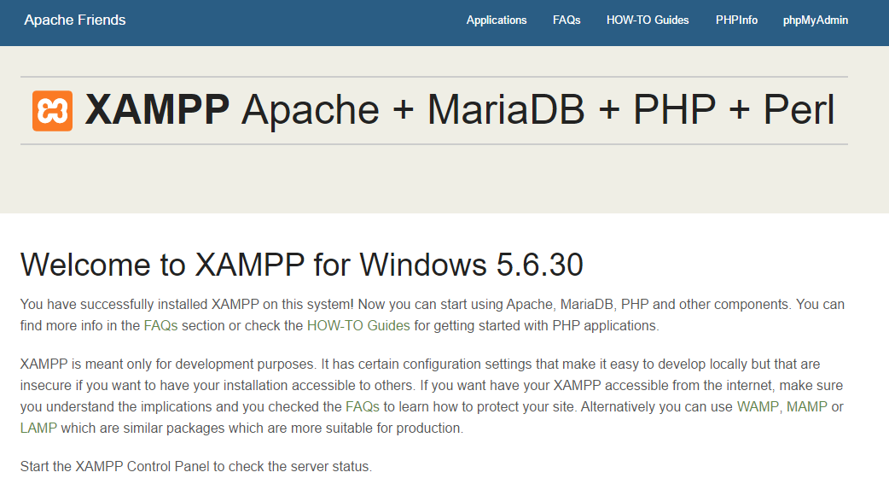
Testing XAMPP
Enter either of the following two URLs into the address bar of your browser:
localhost
127.0.0.1
If you chose a server port other than 80 using the control panel (for example 8010), then you must place a colon followed by that value after either of the preceding URLs—like this: localhost:8010

Slide 9
Testing XAMPP – OS X
To ensure XAMP can take proper control of web serving on your Mac, first you may need to turn off any Apache web server your Mac is already running, by entering the following in a Terminal window:
sudo apachectl stop
Now you can click the middle tab (entitled Manage Servers) at the top of the window, and then click Start All to get the XAMPP servers running.
After this, click the Welcome tab to return to the main Manager screen, and then click the Go to Application button
For more information on installing and using Mac XAMPP, please refer to apachefriends.org/faq_osx.html

Slide 10
Accessing the document root
The document root is the directory that contains the main web documents for a domain.
This is the one that is entered when a basic URL without a path is typed into a browser, such as http://yahoo.com or, for your local server, http://localhost.
By default, XAMP uses the following location for this directory:
C:/xampp/htdocs
To ensure that you have everything correctly configured, you should now create the obligatory “Hello World” file.
So create a small HTML file along the following lines using Windows Notepad or any other program or text editor

Slide 11
Accessing the document root
<html>
<head>
<title>A quick test</title>
</head>
<body>
Hello World!
</body>
</html>
Once you have typed this, save the file into the document root directory previously discussed, using the filename test.html
You can now call this page up in your browser by entering the following URL:
http://localhost/test.html

